Slide 1
React JS
Using Typescript
14th May 2022

Slide 2
Topics
Introduction to ES6
Understanding NPM
Basics of Typescript
Create React App (CRA) with Typescript
React Class with JSX / TSX
React Props
React state and component life cycle
Working with Events
Working with Rest API
Functional Component
React Hooks
Styling in React
React Router
Unit testing
Try AntD with React

Slide 3
GitHub URL
https://github.com/asrafalih/my-react-app

Slide 4
Introduction to ES6
JavaScript ES6 (also known as ECMAScript 2015 or ECMAScript 6) is the newer version of JavaScript that was introduced in 2015.
ES6 is a scripting language specification which is standardized by ECMAScript International.
This specification governs some languages such as JavaScript, ActionScript, and Jscript.
ECMAScript is generally used for client-side scripting, and it is also used for writing server applications and services by using NodeJs.
ES6 allows you to write the code in such a way that makes your code more modern and readable.
ES6 introduces you many great features such as scope variable, arrow functions, template strings, class destructions, modules, etc.

Slide 5
Key Features of ES6
2015
JS 2015
Block binding (let and const keywords)
Arrow Functions
Classes
Promises
Modules (import and export keywords)
Rest/Spread operator
Map and Set objects
2016
JS 2016
Exponentiation operator (**)
Array.prototype.includes
2017
JS 2017
async/await function
2018
JS 2018
Asynchronous Iteration
Promise Finally

Slide 6
Node Package Manager (NPM)
NPM is a critical part of the JavaScript community and helps support one of the largest developer ecosystems in the world.
NPM is the package manager for Node.js. It was created in 2009 as an open source project to help JavaScript developers easily share packaged modules of code.
The npm Registry is a public collection of packages of open-source code for Node.js, front-end web apps, mobile apps, robots, routers, and countless other needs of the JavaScript community.
npm is the command line client that allows developers to install and publish those packages.

Slide 7
Install Node and NPM
NPM will be installed along with NodeJs installtion.
Download and install NodeJs using this link https://nodejs.org/en/download/
After installation check npm version using this command npm -v

Slide 8
Understanding of Typescript
You’ve probably already heard that TypeScript is a “flavor” or “variant” of JavaScript.
TypeScript is a programming language developed and maintained by Microsoft.
Static Type Checker
Detecting errors in code without running it is referred to as static checking.
TypeScript checks a program for errors before execution, and does so based on the kinds of values, it’s a static type checker.
Typed Superset of JavaScript
TypeScript is a language that is a superset of JavaScript: JS syntax is therefore legal TS.

Slide 9
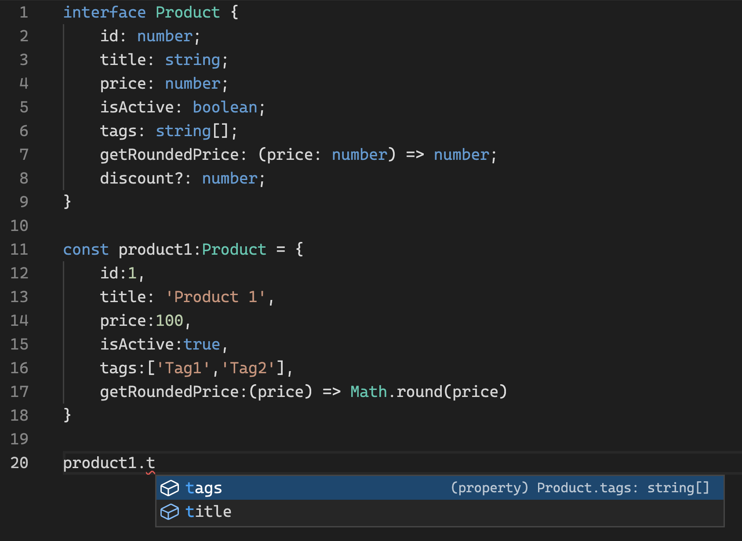
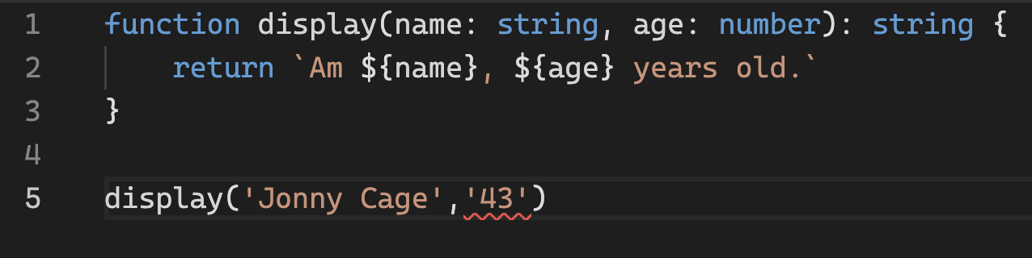

Slide 10
Introduction to React JS
React is a JavaScript library for building user interfaces.
React is used to build single-page applications.
React makes it painless to create reusable interactive UI components.
React will efficiently update and render just the right components when your data changes.
React is maintained by Meta (formerly Facebook)
Notable feature of React is virtual DOM. It creates an in-memory data-structure cache, computes the resulting differences, and then updates the browser's displayed DOM efficiently.

Slide 11
Install React with Typescript (CRA)
Use the following commands to create react application.
npx create-react-app my-react-app --template typescript
cd my-react-app
npm start
Then browser will open automatically and render the home page of react app.

Slide 12
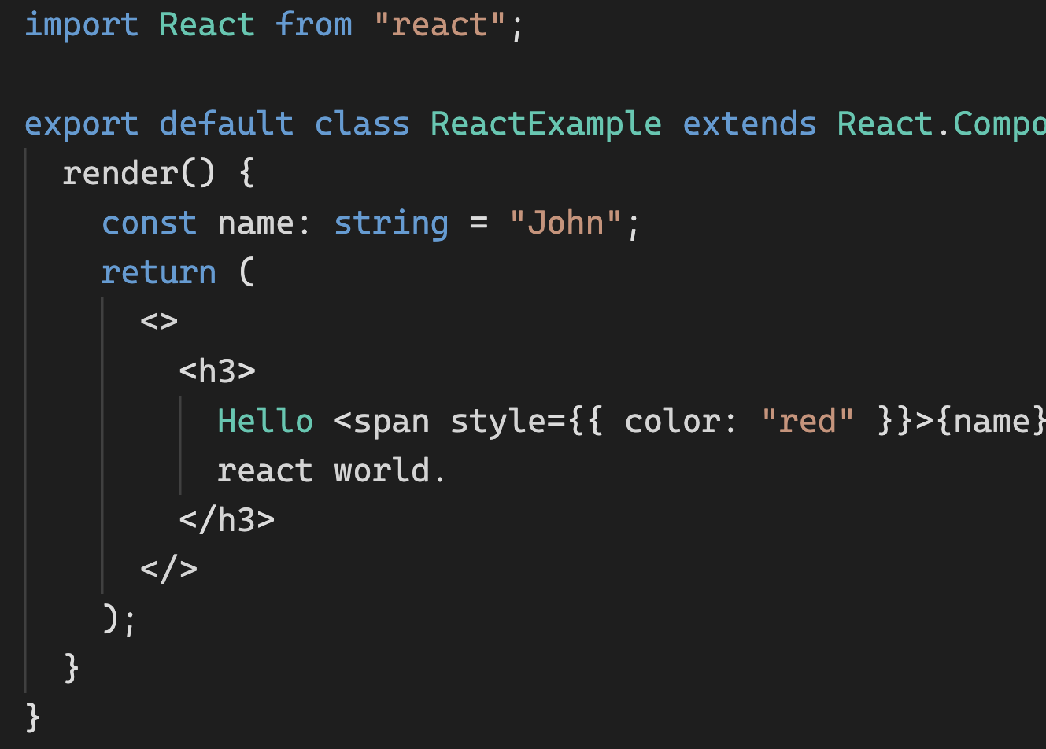
React class with JSX / TSX
All React class must have render() methods to render UI elements.
JSX is syntax extension to JavaScript. Similarly, TSX is syntax extension to Typescript.
JSX may remind you of a template language, but it comes with the full power of JavaScript.
Most people find it helpful as a visual aid when working with UI inside the JavaScript code.

Slide 13
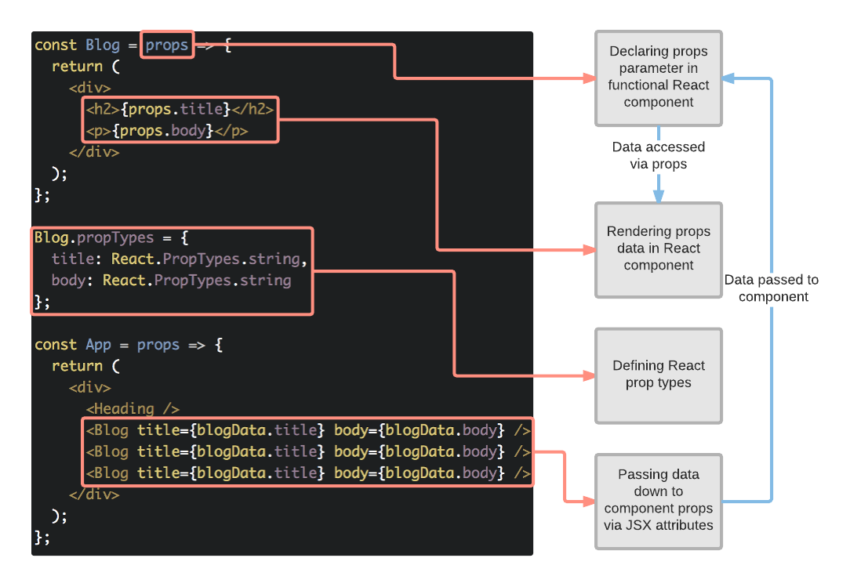
React Props
React Props are like function arguments in JavaScript and attributes in HTML.
To send props into a component, use the same syntax as HTML attributes
We can pass data into the components through props only.
Props can be method to emit event to parent component.
Children elements can be accessed through `this.props.children`

Slide 14
React State
React components has a built-in state object.
The state object is where you store property values that belongs to the component.
When the state object changes, the component re-renders.
State can be accessed through `this.state.propertyname`
State can be modified through `this.setState({propertyname: somevalue})`
Always use the setState() method to change the state object, it will ensure that the component knows its been updated and calls the render() method (and all the other lifecycle methods).

Slide 15
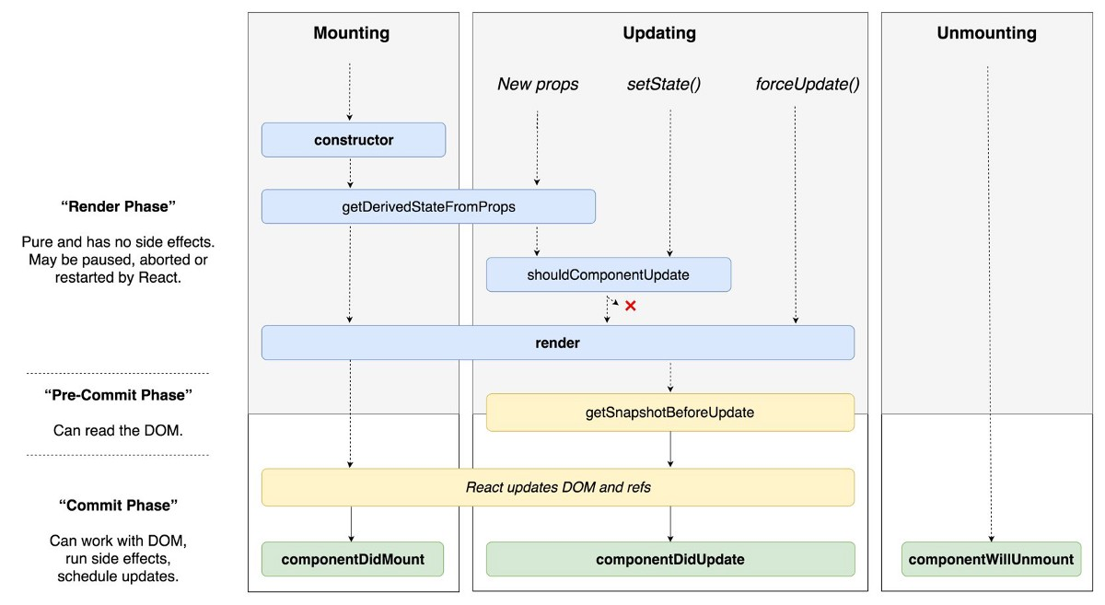
React Lifecycle
Mounting: The methods and events that take place here happen as the component is mounted in the DOM.
Updating: Here the methods and events take place after the React component has entered the DOM.
Un-mounting: Here the methods and events take place as they React component leaves the DOM or is unmounted from the DOM.

Slide 16
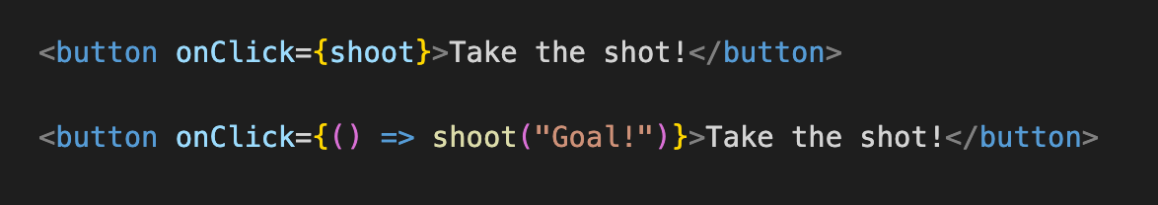
React with Events
Just like HTML DOM events, React can perform actions based on user events.
React has the same events as HTML: click, change, mouseover etc.
React events are written in camelCase syntax like onClick instead of onclick.
React event handlers are written inside curly braces like onClick={shoot} instead of onClick="shoot()"

Slide 17
Working with Rest API
React application can load a data from REST APIs.
Developers can use various HTTP clients to load REST API data like fetch (in-built), axios, etc
`componentDidMount` method will be used to initiate the AJAX/REST API call.
`this.setState` method will be used to set the data from successful response of REST API

Slide 18
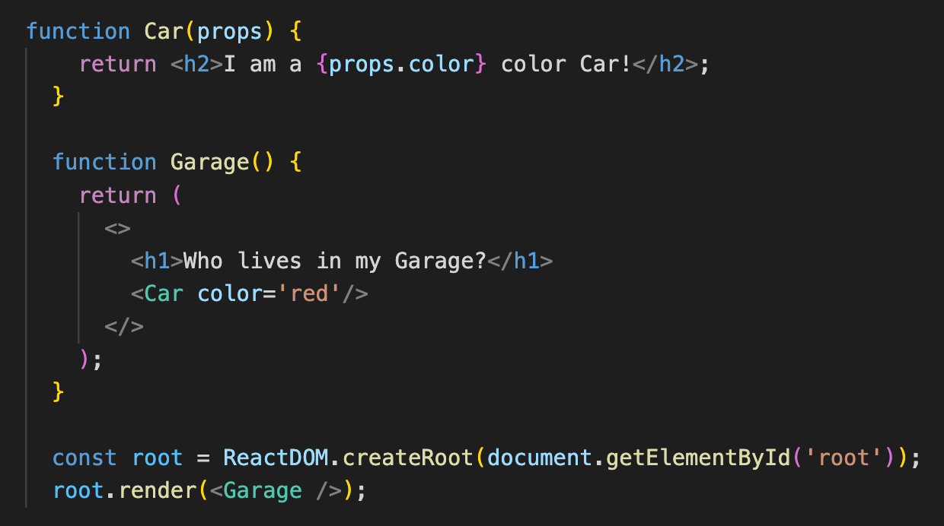
Functional Component
A Function component also returns HTML, and behaves much the same way as a Class component.
Function components can be written using much less code, are easier to understand.

Slide 19
React Hooks
Hooks were added to React in version 16.8.
Hooks allow function components to have access to state and other React features.
Because of this, class components are generally no longer needed.
Hooks allow us to "hook" into React features such as state and lifecycle methods.
There are 3 rules for hooks:
Hooks can only be called inside React function components.
Hooks can only be called at the top level of a component.
Hooks cannot be conditional
UseState and useEffect are most important React Hooks.

Slide 20
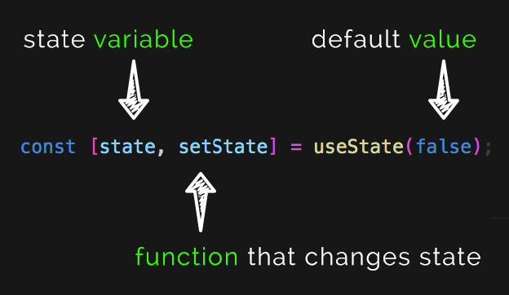
useState Hook

Slide 21
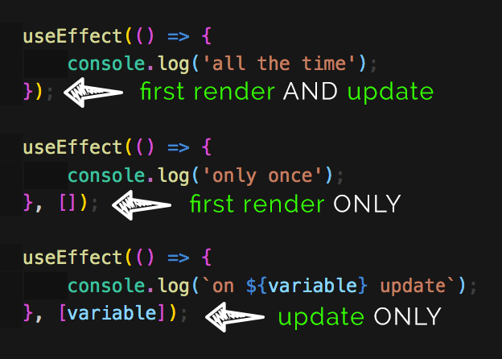
useEffect Hook

Slide 22
Styling in React
In JSX, JavaScript expressions are written inside curly braces, and since JavaScript objects also use curly braces, the styling in the example above is written inside two sets of curly braces {{}}
<h1 style={{color: "red"}}>Hello Style!</h1>
camelCased Property Names
Use backgroundColor instead of background-color
HTML element class attribute should be used as className='bigblue' instead of class='bigblue'
<h1 className='bigblue'>Hello Car!</h1>

Slide 23
React Router
Create React App doesn't include page routing.
React Router is the most popular solution.
Component will be loaded based on the path of the URL
/home - Supposed to load Home page component
/contact - Supposed to load Contact Us page
/about - Supposed to load about page
/ - This also supposed to load home page

Slide 24
Unit testing in React
Nobody wants buggy code, so we need test code whatever we written.
Unit tests will avoid surprising errors in the production environments.
Jest with React is the widely used test suite.
There are several testing libraries for react.
In unit testing, we should mock the external data like REST APIs, graphql
Through unit test we can test different functionalities of the component which we written.
Code Coverage will identify which piece of developed code tested/not tested.

Slide 25
AntD with React
Please use the following link to install AntD with typescript
https://ant.design/docs/react/use-in-typescript

Slide 26
References
https://reactjs.org/tutorial/tutorial.html
https://www.w3schools.com/react/default.asp
https://www.tutorialspoint.com/reactjs/index.htm
https://www.geeksforgeeks.org/reactjs-tutorials/
https://www.typescriptlang.org/assets/typescript-handbook.pdf
https://edu.anarcho-copy.org/Programming%20Languages/Node/Pro%20MERN%20Stack,%202nd%20Edition.pdf

Slide 27
Any Questions?

Slide 28
Thank You!
Email: asraf.cse@gmail.com
GitHub Link: https://github.com/asrafalih

